Slide 2
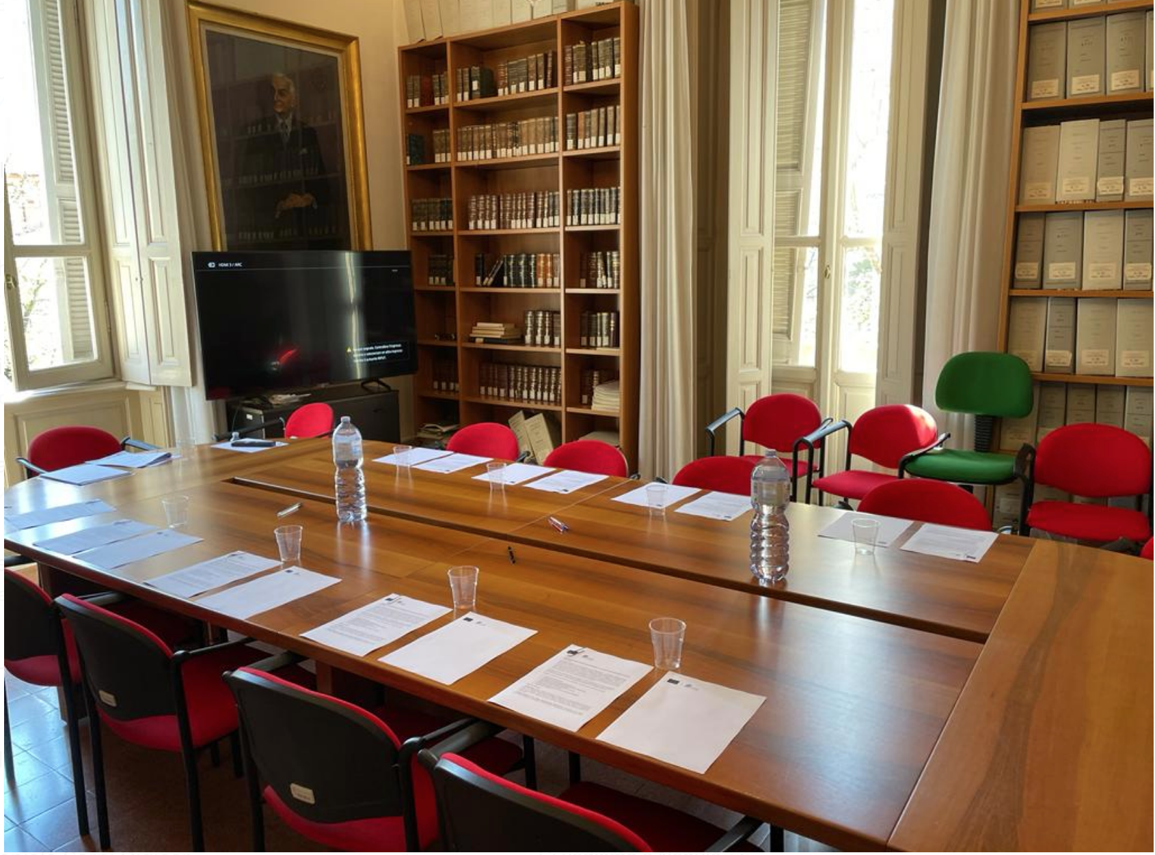
01. Focus Group
A focus group was organized in Sassari (Italy) the 04/20/2023 involving eight stakeholders selected via purposive sampling (Bryman and Bell 2015).

Slide 3
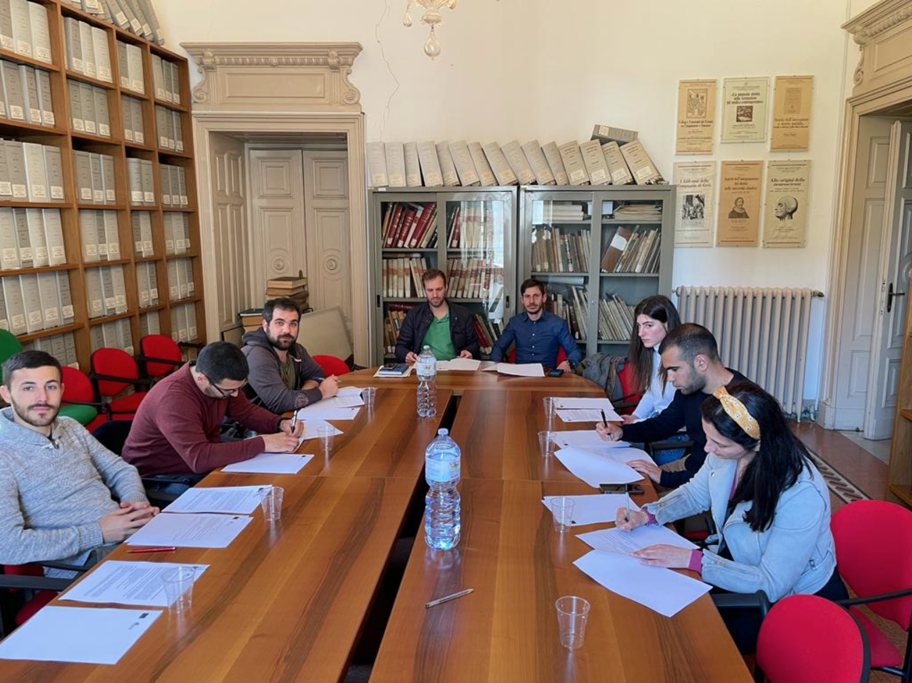
02. Profile
3 PhD Students
2 Museum managers
3 University Students
They were two women and six men
The youngest was 24 years old and the oldest 41
geographically they were from different towns across Sardinia (Italy)

Slide 4
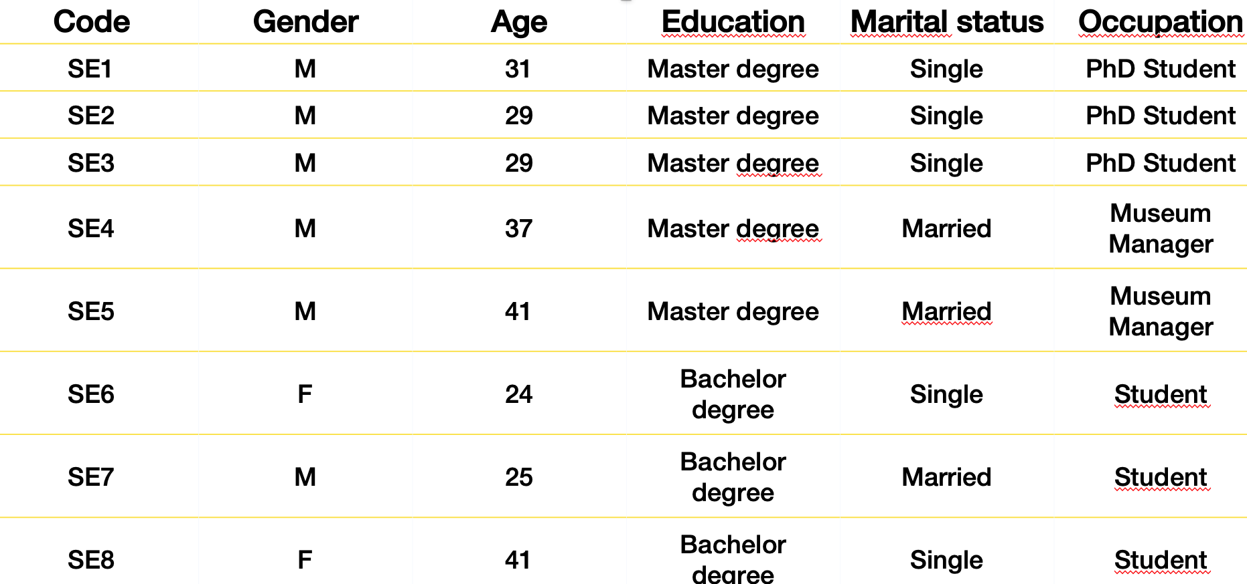
02. Profile

Slide 5
03. Methodology and analysis
The interviews were recorded and then transcribed;
The text was analyzed according to a series of iterative steps and following the typical approach suggested by the "grounded theory" (Charmaz 2000; Glaser 1978; Glaser and Strauss 1967).
The texts were codified and grouped into themes or dimensions through thematic coding (Braun and Clarke 2006) that could summarize their meaning.
Thematic analysis of the interviews allowed to identify emerging dimensions and perception involved in internship program/projects, with particular attention to remote internship.

Slide 6
04. Findings
Respondents generally agree that remote internships can be beneficial, but they need to be well-planned in advance. (8/8)
The trainee's tasks must be clearly identified and the coordinator should provide constant and consistent attention. (8/8)
It is possible to have a successful remote internship, but it requires a precise project and close supervision. (8/8)
However, remote internships are not suitable for activities that require an on-site presence (i.e. materials study) (6/8)

Slide 7
04. Findings
Respondents generally agree that a remote internship could lead to the same results as an in-person one. (7/8)
However, they highlighted the lack of “human touch” that in-person internships offer. (5/8)
Furthermore, the achievement of similar results depends on the field and the skills of the trainee. (6/8)
While some tasks can be virtualized, others cannot and require face-to-face interaction. (7/8)
For example, a museum guide cannot effectively train remotely.
However, certain activities such as meetings or discussing topics can still be done via video call. (8/8)

Slide 8
04. Findings
An ideal remote internship should be:
perfectly organized in tasks and objectives (8/8)
be mutually beneficial for the trainee and the trainer (6/8)
have a perfect schedule with meetings and assessments per week. (8/8)
It should also pay attention to insurance/safety (5/8)
have a strong support from the University tutor and actual presence/involvement. (8/8)

Slide 9
04. Findings
All the participants expressed positive opinions about the journey map as a whole. (7/8)
In particular, they actually liked the idea to organize the process in tasks and the autonomy that the trainee will have in terms of time to complete the tasks. (8/8)
Secondly, they agree with the idea to develop a common platform in order to reduce the “software divide” among stakeholders, better if in cloud. (7/8)
At the same time, they expressed skepticism about the lack of connection with other people that could lead to a sense of loneliness (5/8)

Slide 10
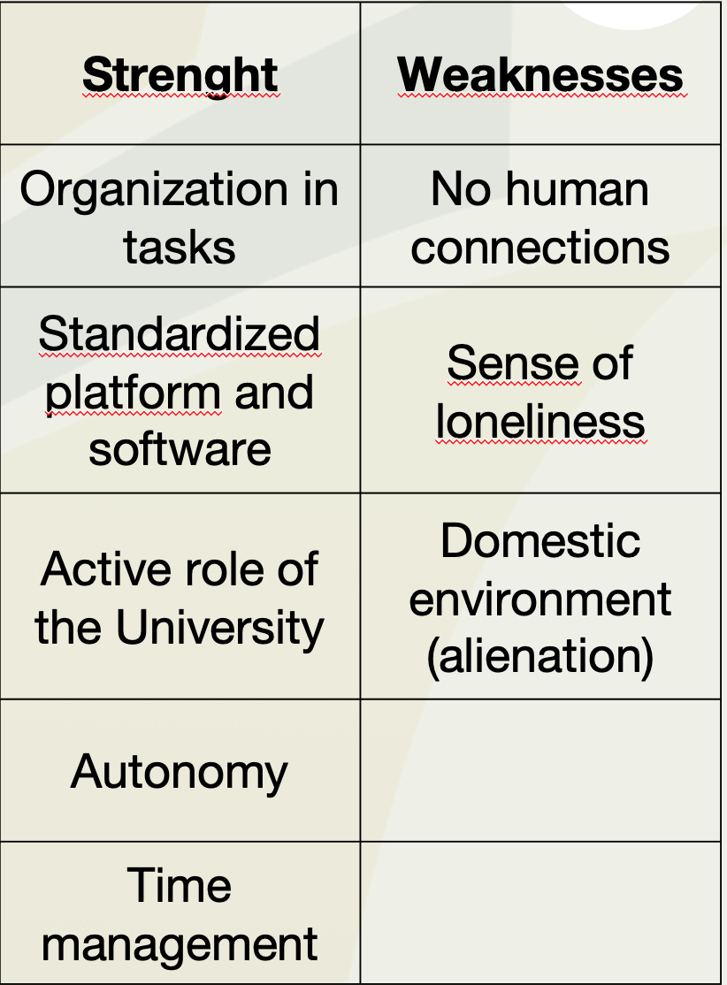
04. Findings
Plan that includes a timetable with deadlines and an organized structure. (8/8)
Need for improved human connections to counter a sense of loneliness. (5/8)
Standardized platform (7/8)
Time management is a big advantage (8/8) as is the active involvement of the university tutor (8/8)
Finally, one of the negatives of remote internships is that it can make people feel isolated (5/8)

Slide 11
04. Findings
A remote internship can be measured by its success if the project is very detailed with specific result indicators. (5/8)
It is easier to measure the success of a remote internship than in-person as the objectives are clear. (5/8)
Internships are beneficial as they provide knowledge and experience, which are not typically acquired through University (6/8)
Working on a remote internship can be a challenge, however with the right attitude, it can be a rewarding experience (8/8).

Slide 12
Thank you for your attention ;-)
Contacts of the presenter: Marcello Atzeni, matzeni1@uniss.it

