Slide 2
Survey on needs and expectations of students and graduates on high quality remote internships

Slide 3
Survey on needs and expectations of students and graduates on high quality remote internships - Objectives
A survey has been developed aiming to collect the opinions and attitudes of STUDENTS, ACADEMIC and COMPANIES towards an ideal remote internship.
The questionnaire consists of statements regarding work arrangements, expected mentoring and employability benefits, learning content, academic supervision and various competencies that can be developed through remote internships. In addition, the questionnaire contains statements reflecting attitudes towards ideal distance internships.
More than 250 questionnaires have been already collected.

Slide 4
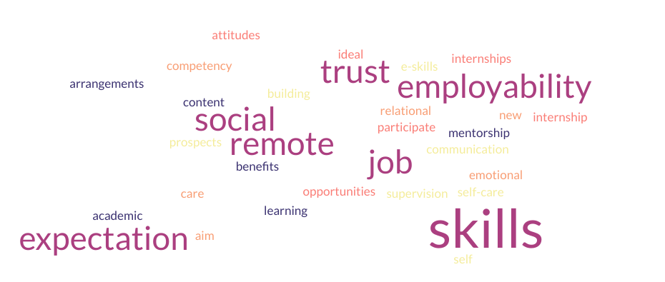
Survey on needs and expectations of students and graduates on high quality remote internships – Expectations Area for an ideal remote internship
#1 The job arrangements
# 2 Expected remote mentorship and employability benefits
# 3 Expected learning content
# 4.The expected academic supervision
# 5 The expectation in terms of communication skills
# 6 Expectation in terms of job prospects
# 7.Expectation in terms of e-skills
# 8. Expectation in terms of trust building skills
# 9. Expectation in terms of self-care skills
# 10. Expectation in terms of remote social skills
# 11. Expectation in terms of remote emotional skills
# 12. Expectation in terms of new skills
# 13. Aim to participate in an ideal remote internship
# 14. The attitudes towards remote internships

Slide 5
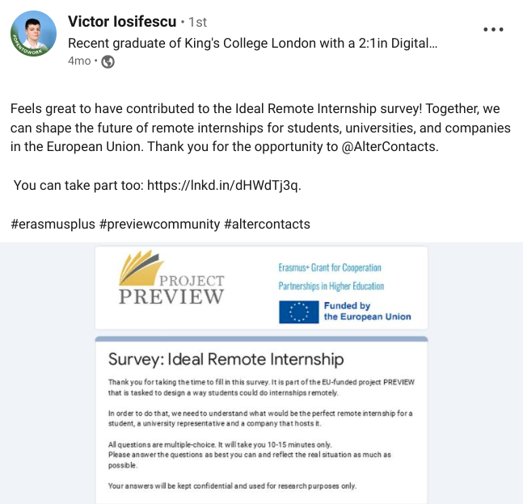
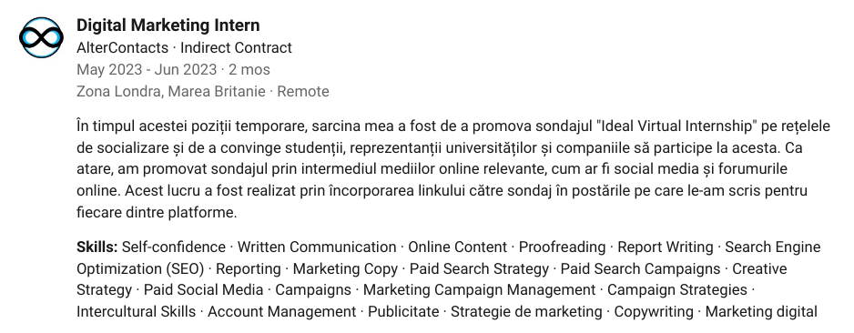
Our first remote intern - a Romanian student in London

Slide 6
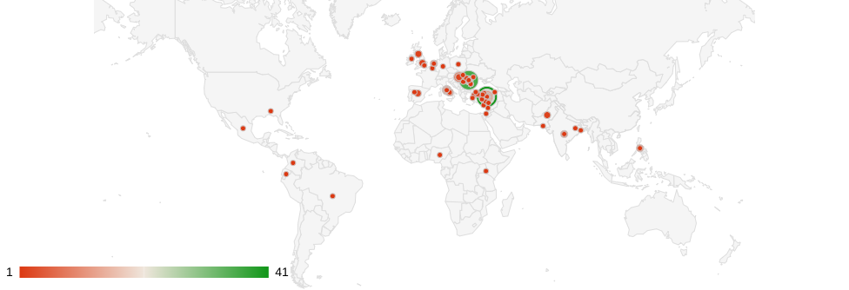
Survey on needs and expectations of students and graduates on high quality remote internships – Country coverage

Slide 7
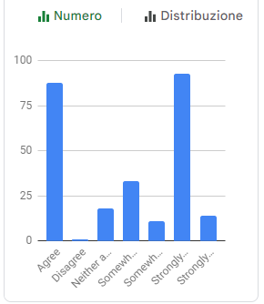
Survey on needs and expectations of students and graduates on high quality remote internships – Expectations for an ideal remote internship 1/8
#1 The job arrangements
1. Appreciate the following statements regarding the job arrangements for an ideal remote internship,
using the scale 1 (strongly disagree) – 7 (strongly agree):
[It will be a very well-organized on boarding period and a presentation of the organization]

Slide 8
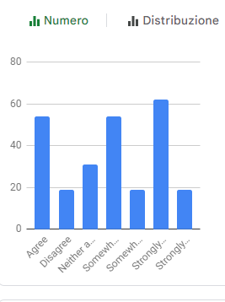
Survey on needs and expectations of students and graduates on high quality remote internships – Expectations for an ideal remote internship 1/8
# 2 Expected remote mentorship and employability benefits
2. Appreciate the following statements regarding the expected remote mentorship and employability benefits,
using the scale 1 (strongly disagree) – 7 (strongly agree):
[The students remote relation with the colleagues will be very good]

Slide 9
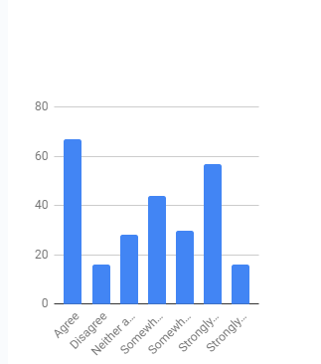
Survey on needs and expectations of students and graduates on high quality remote internships – Expectations for an ideal remote internship 1/8
# 3 Expected learning content
.
3. Appreciate the following statements regarding the expected learning content of an ideal remote internship,
using the scale 1 (strongly disagree) – 7 (strongly agree):
[There will be a strong connection between students field of studies and the field of the remote internship]

Slide 10
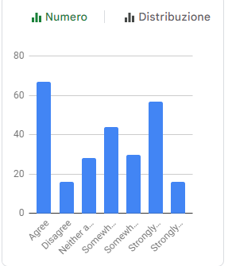
Survey on needs and expectations of students and graduates on high quality remote internships – Expectations for an ideal remote internship 1/8
# 5 The expectation in terms of communication skills
5. Appreciate the following statements regarding the expected communication skills of an ideal remote internship,
using the scale 1 (strongly disagree) – 7 (strongly agree):
[Remote internship experience will improve students' online written communication skills]

Slide 11
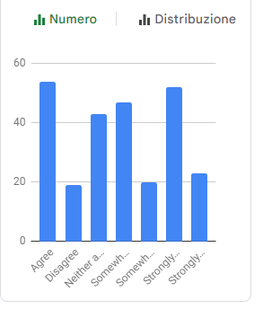
Survey on needs and expectations of students and graduates on high quality remote internships – Expectations for an ideal remote internship 1/8
# 6 Expectation in terms of job prospects (after a remote internship)
6. Appreciate the following statements regarding the improved job prospects after an ideal remote internship,
using the scale 1 (strongly disagree) – 7 (strongly agree):
[I feel remote internship is an effective strategy for students to gain employment]

Slide 12
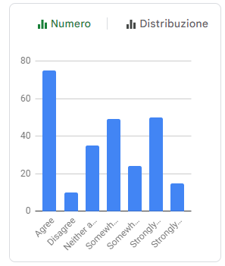
Survey on needs and expectations of students and graduates on high quality remote internships – Expectations for an ideal remote internship 1/8
# 8. Expectation in terms of trust building skills (Trust competency)
8. Appreciate the following statements regarding the improved job prospects after an ideal remote internship,
using the scale 1 (strongly disagree) – 7 (strongly agree):
[I feel remote internship is an effective strategy for students to gain employment]

Slide 13
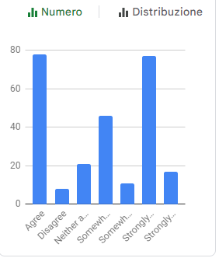
Survey on needs and expectations of students and graduates on high quality remote internships – Expectations for an ideal remote internship 1/8
# 12. Expectation in terms of new skills
12. Appreciate the following statements regarding the expected new skills of an ideal remote internship,
using the scale 1 (strongly disagree) – 7 (strongly agree)
[Students will develop new skills and knowledge as a result of their virtual training]

Slide 14
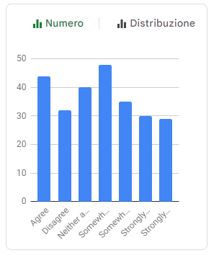
Survey on needs and expectations of students and graduates on high quality remote internships – Expectations for an ideal remote internship 1/8
# 14. The attitudes towards remote internships
14. Appreciate the following statements regarding the attitudes towards remote internships,
using the scale 1 (strongly disagree) – 7 (strongly agree):
[A remote internship would provide students with an equivalent experience to a traditional onsite internship]

Slide 15

PREVIEW QUESTIONNAIRE

Slide 16

https://docs.google.com/forms/d/e/1FAIpQLSfrfvlh8cffA10Hc-TXtmij1VzCVlr9SR4yPBh5Iz2We3mL8g/viewform

