Slide 2
PREVIEW Promoting Resilience and Employability in university students through Internship for futurE Work
An overview on accomplished activities
October 10th, 2023 (11-12)
ERASMUS + Call 2022 Round 1 KA2 KA220-HED - Cooperation partnerships in higher education

Slide 3
Project general objective
The project envisages the design, development and testing of an innovative university course which, through remote internships and other e-Learning by doing activities, will enable students and graduates to develop the employability competences required by the remote working scenario.
- Students and graduates will be trained -through e-learning activities- with competences to address the challenges of distance and effectively work in remote working context: e.g. how to use different technologies, how to work and collaborate in virtual teams, how to re-organize work activities using new digital and connectivity tools.
- Subsequently, they will have the opportunity to applicate these competences during remote internships, and verify to what extent they are able to work in a remote context, and effectively interact and collaborate with distant colleagues.

Slide 4
WHAT WE HAVE DONE IN THIS FIRST YEAR

Slide 5
WE HAVE MOSTLY WORKED ON
WP 2 BUILDING THE COMPETENCES FOR REMOTE WORK IN THE ACADEMIC COMMUNITY OF TOMORROW (ASE)
develop the Remote Internship Blueprint based on a map of the Internship process in the involved
universities, a survey on students and graduates about their expectations on key remote competences,
a collaborative laboratory with stakeholders to design the remote internship experience following the
Design thinking methodology.

Slide 6
Task 2.1.
Programme Internship Process Mapping (M1-M6) Led by ASE
Task 2.2.
Survey on needs and expectations of students and graduates on high quality remote internships. (M3-M8) Led By ASE
Task 2.3
Service Design Living and Collaborating Laboratories (M6-M16) Led by USAL
Task 2.4
Task 2.5
Building out the Remote Internship blueprints (M10-M16)
L&T course about Service Design Methodology (M4 - M5) Led By USAL and CNR

Slide 7

T2.1 Programme Internship Process Mapping Led by ASE
Based on materials collected, ASE provided a comprehensive overview of the internship process in the four university partners including:
- benefits/obligations of the key actors involved in the internship (i.e., university teachers and tutors, students, and company mentors),
- administrative and bureaucratic procedures (e.g., job description, protocol);
- challenges posed by the COVID-19 pandemic and the strategies employed by universities to adapt and manage internships during this period.
It also highlights the importance of a common theoretical framework regarding internships in universities, specifically focusing on the Experiential Learning Cycle developed by David Kolb. This framework emphasizes the significance of active participation and reflection in the learning process, providing a continuous and experiential approach to internships.
Deliverable 2.1 Programme Internship Process Description in PREVIEW Partner Countries

Slide 8

T 2.2 Survey on needs and expectations of students and graduates on high quality remote internships Led By ASE
A survey has been developed aiming to collect the opinions and attitudes of STUDENTS, ACADEMIC and COMPANIES towards an ideal remote internship.
The questionnaire consists of statements regarding work arrangements, expected mentoring and employability benefits, learning content, academic supervision and various competencies that can be developed through remote internships. In addition, the questionnaire contains statements reflecting attitudes towards ideal distance internships.
More than 250 questionnaires have been already collected. More details will be provided in the following by Altercontact and ADI Harghita.
By the end of the October 2023, data analysis and the drafting of the deliverable 2.2. will be completed.

Slide 9
T 2.5 L&T course about Service Design Methodology Led By USAL and CNR (1/3)
The activities have been organized in two sessions (online and physical):
The first session has been held online and it has been dedicated to theoretical principles and approach to the Service Design Methodology (20-22 February, 2023). The course was open also to HR managers, administrative and teaching staff of each university and interested parties from other PREVIEW partners.
The second session has been held in Salamanca (from February 27th to March 2nd, 2023) where partners collaborated to develop a first draft of Remote Internship Blueprint (RIB) and journey map based on the Service design Methodology.
Deliverable 2.5 Report on L&T course about Service Design Methodology
A first draft of the Remote Internship Blueprint (RIB) has been elaborated

Slide 10
T 2.5 L&T course about Service Design Methodology Led By USAL and CNR (2/3)
A first draft of the Remote Internship Blueprint (RIB)
- identification of the “steps of the students’ remote internship journey”, including:
1.Awareness;
2. Interest/decision;
3. Onboarding (University and Company);
4. Internship/Execution/Performance;
5. Learning appraisal/ Continuous feedback;
6. Evaluation form/Final Report/Meeting with tutor
- identification of “touchpoints” are how and/or the means of exchange between the student and the remote internship service (e.g., through which device/media).
- identification of personas supporting the remote internship design process: the innovator, the skill builder, the career starter, the explorer, the community builder.

Slide 11
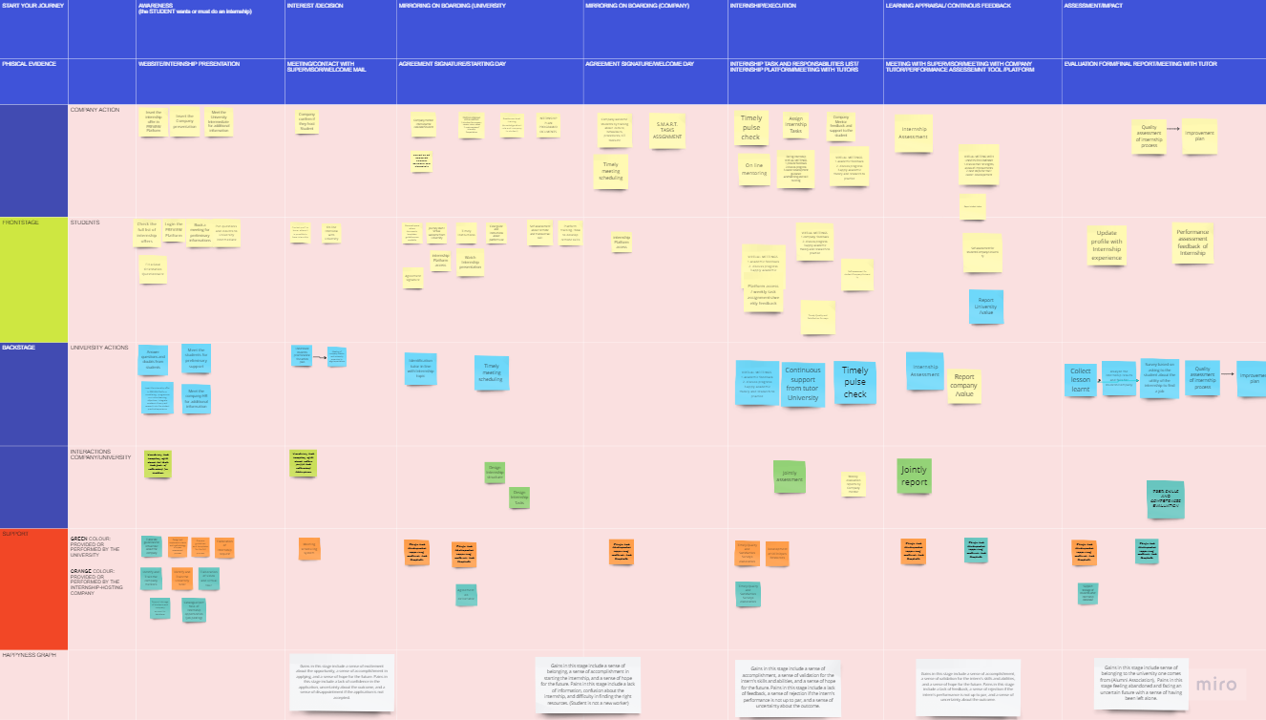
T 2.5 L&T course about Service Design Methodology Led By USAL and CNR (3/3)
https://miro.com/app/board/uXjVMToMOy8=/

Slide 12
Task 2.3 Service Design Living and Collaborating Laboratories Led by USAL
After the Service Design laboratory in Salamanca, each University partner has organized a local focus group with key stakeholders involved in remote internship (i.e., university teachers and tutors, students, and company mentors) to collect feedback, comments, and suggestions about the Remote Internship Blueprint (RIB) and journey map elaborated in Salamanca.
To this end, a toolkit has been developed by USAL and CNR ISMed to provide a common guide and templates for local focus groups. Collected materials have been coded by each partner based on conceptual categories provided by USAL.
USAL is working on aggregate data analysis and deliverable 2.3. drafting.

Slide 13
WE HAVE ALSO WORKED ON
WP 3 - PREVIEW LEARNING/TEACHING HUB (CNR ITD)
develop an online platform with courses on key remote competences for students and graduates, university staff, company mentors, professionals.

Slide 14
T 3.1 PREVIEW online digital platform led by CNR ITD
T 3.2 Learning/teaching HUB led by CNR ITD
- selection of open-source and/or custom tools and technical systems to be integrated into the PREVIEW learning/teaching HUB
- identification of activities and Informational flow related to the PREVIEW Remote Internship Blueprint;
- development of the online digital platform
CNR ITD will draft deliverable 3.3 PREVIEW Learning Resources (M16); deliverable 3.4 User Guide by CNR (M18); deliverable 3.1 PREVIEW Learning/Teaching HUB by CNR (M20).

Slide 15
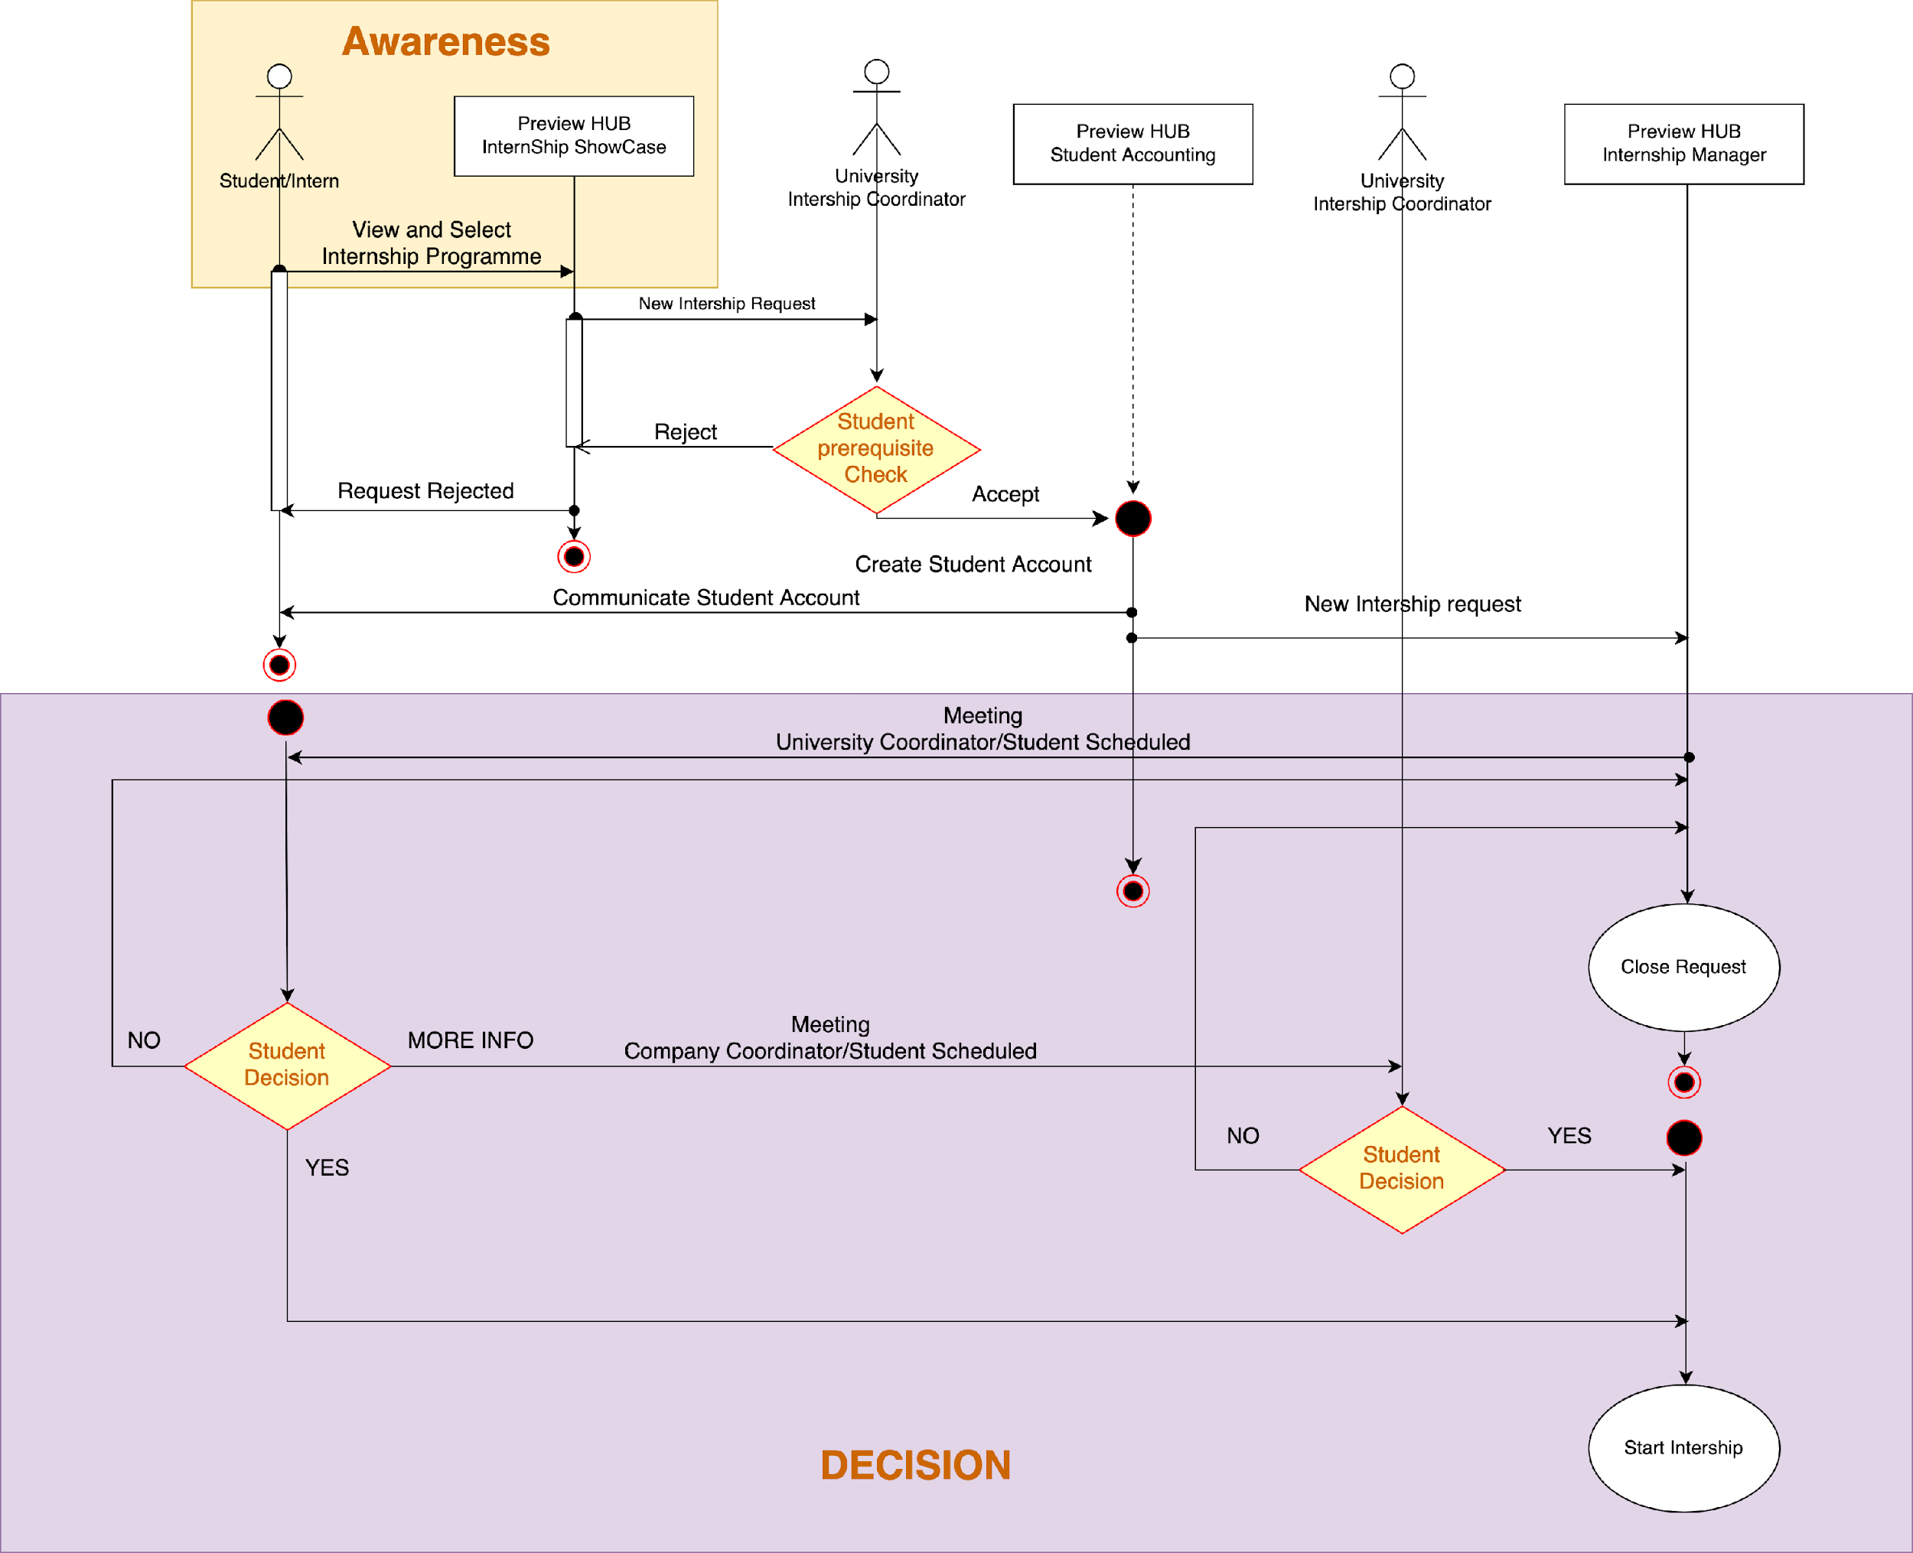
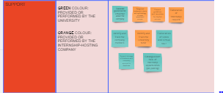
Preview Remote Internship Blueprint

Slide 16
NEXT STEPS

Slide 17

WP 2 BUILDING THE COMPETENCES FOR REMOTE WORK IN THE ACADEMIC COMMUNITY OF TOMORROW (ASE)
Task 2.4 Building out the Remote Internship blueprints Led By USAL
Based on previous tasks 2.1., 2.2., 2.3., 2.5 a Remote Internship Blueprint (RIB) will be designed to provide a map that accurately describes the internship “system”, i.e. service components (people, props (physical or digital evidence), and processes that are directly tied to touchpoints in a specific customer journey
Deliverable 2.4 Guide for a Successful Internship Programme (M16) led by USAL

Slide 18
WP 3 - PREVIEW LEARNING/TEACHING HUB (CNR ITD)
T 3.3 Set of learning resources led by USAL
Identification of learning resources about key remote competencies to be included into the learning/teaching platform and organized as a MOOC.
Deliverable 3.2 PREVIEW Learning/teaching HUB Tools by USAL (M16)
T3.4 Preview HUB training led by CNR ITD
A peer-to-peer training by CNR ITD about the use of the VIEW learning/teaching HUB
Deliverable 3.5 Report on Preview HUB training by CNR (M20)

Slide 19
WP 4 - PREVIEW MODEL FOR INNOVATIVE CURRICULUM WITH REMOTE INTERNSHIP IN HIGHER EDUCATION. LESSONS LEARNED FROM PREVIEW CONSORTIUM (UNISS)
organization of an innovative educational path that combines e-learning activities with remote internship for 90 students and graduates (at least 16 students and graduates with economic and geographical disadvantages)

Slide 20
Thank you for your attention!
Tommasina Pianese, CNR ISMed
Daniela De Gregorio, CNR ISMed

